Slide 1
Project Presentation of Exploratory Project (EP)
On
Adaptive Data Science Language Model
KARTIKEYA JAIN
2310991865
Department of Computer Science and Engineering,
Chitkara University, Punjab

Slide 2

Introduction
ADSLM: Adaptive Data Science Language Model
An Intelligent AutoML & Data Science Copilot
for Industrial Datasets
AutoML Explainable AI
Adaptive Insights Predictive Maintenance
2

Slide 3

The Problem: Manual ML Development is Costly
Why Industrial Data is Hard
Traditional ML Workflow
Industrial datasets contain mixed data types, missing values, outliers, and complex relationships.
Different users also require different levels of explanation — from plant operators to data scientists.
Profile & clean raw data manually
Select ML task & algorithms
Train, compare & evaluate models
Interpret predictions & write reports
Proposed Solution: ADSLM automates the complete pipeline
Raw CSV → Analysis → Model → Evaluation → Explanation → Insights → Report
3

Slide 4

Objectives & Project Scope
Core Objectives
Supported ML Tasks
01
Automate dataset profiling & data-quality analysis
Classification
02
Clustering
Detect ML task automatically (classification, regression, clustering, time-series)
Regression
03
Preprocess data & recommend suitable algorithms
Time-Series
04
Train, compare & select the best-performing model
05
Provide Explainable AI with adaptive natural-language insights
Primary Application:
Industrial Predictive Maintenance
06
Generate structured reports & interactive dashboard
4

Slide 5
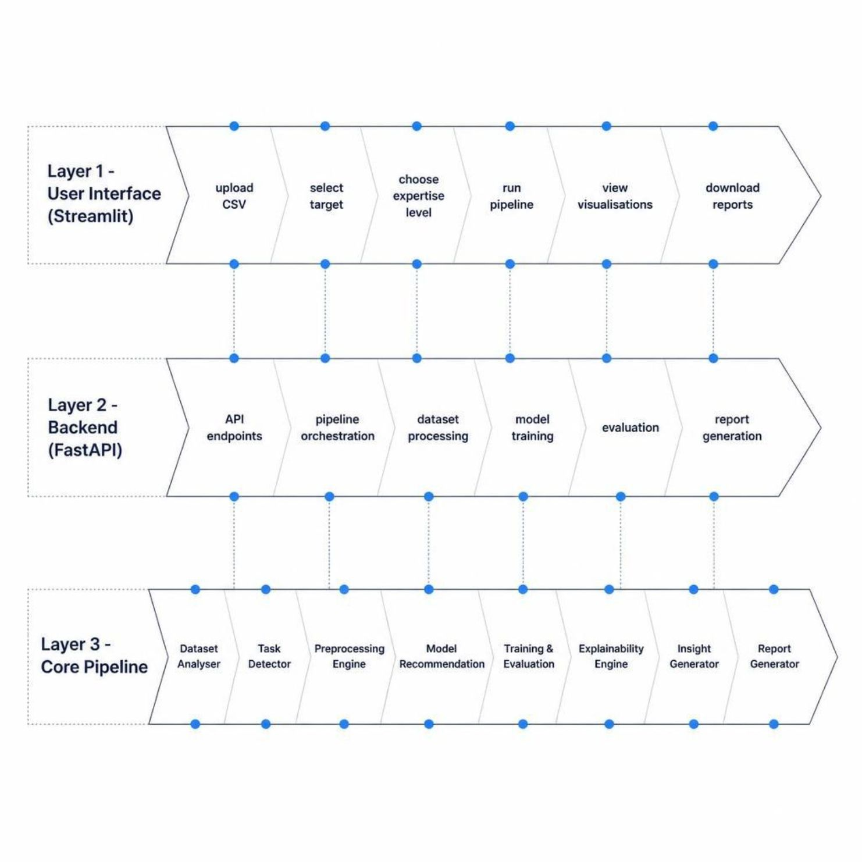
Proposed System Architecture
Architecture Overview
ADSLM follows a clean three-tier architecture.
The Streamlit frontend provides an intuitive UI for dataset upload, configuration, and result visualisation.
The FastAPI backend orchestrates the pipeline through RESTful endpoints.
The Core Data Science Engine executes eight sequential stages from raw data ingestion to final report generation with zero manual intervention.
5

Slide 6
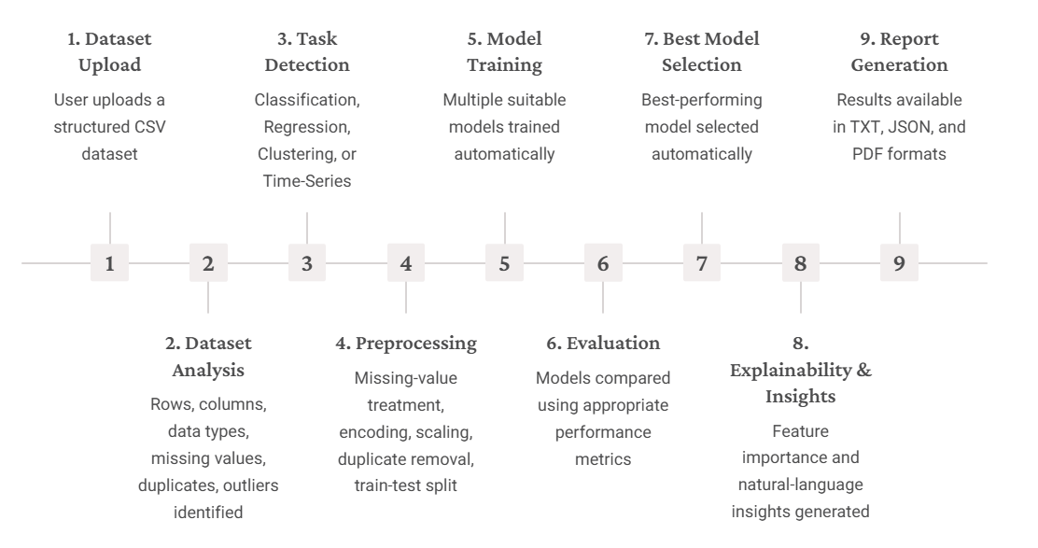
End To End Workflow
6

Slide 7
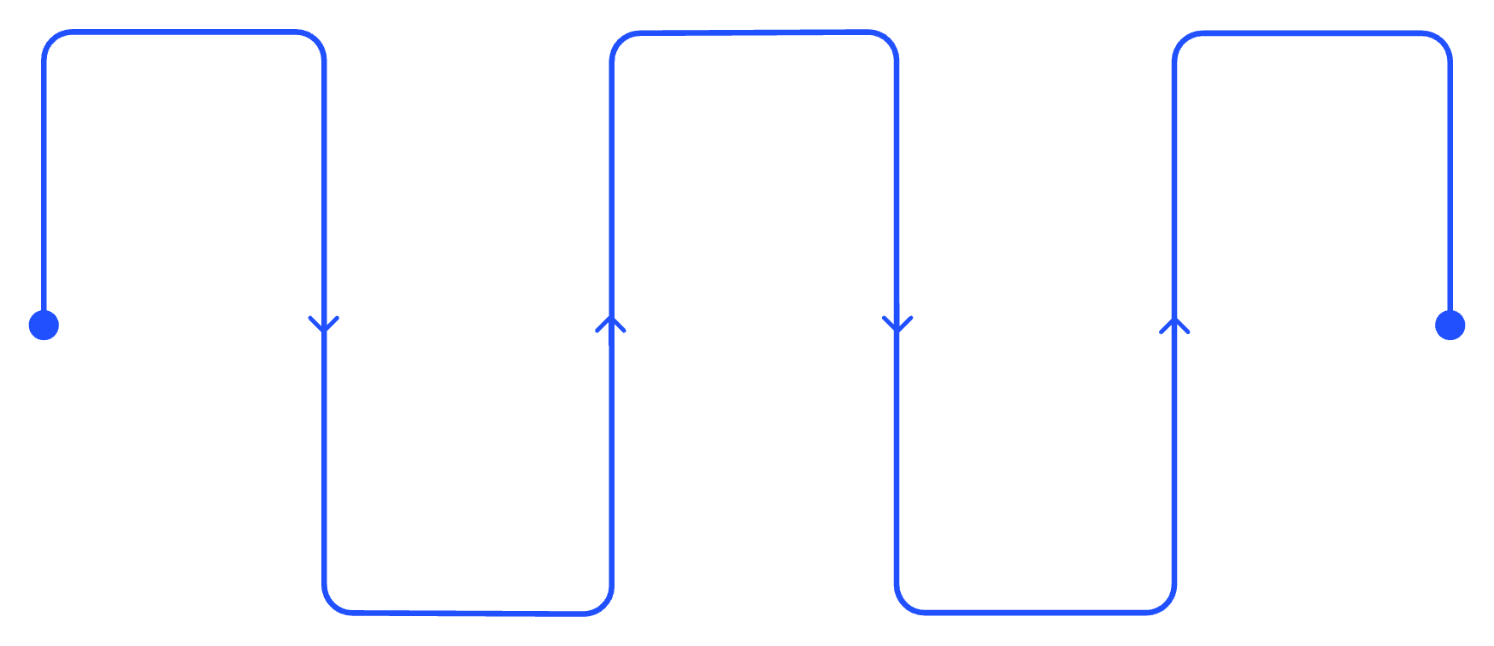

Dataset & Preprocessing Pipeline
Industrial Predictive Maintenance Dataset
Feature | Description
Machine_ID | Machine identifier
Temperature_C | Machine temperature
Vibration_mm_s | Vibration level
Pressure_bar | Pressure reading
RPM | Rotational speed
Oil_Level | Lubrication level
Fault (Target) | Machine fault condition
Preprocessing Pipeline
Remove Duplicates
Encode Categoricals
Train/Test Split
Divide data for evaluation
Eliminate repeated records
Transform categorical fields
Handle Missing Values
Scale Numerical
Impute or remove gaps
Normalize or standardize features
Since Fault is a discrete categorical variable, ADSLM automatically detects this as a Classification problem.
7

Slide 8
Machine Learning & Evaluation
Model Recommendation by Task
Evaluation Metrics
Classification
Regression
Classification
Regression
Logistic Regression, Random Forest, SVM, XGBoost
Linear Regression, Random Forest Regressor, XGBoost Regressor
Accuracy · Precision · Recall · F1-Score · Confusion Matrix
RMSE · MAE · R² Score
Clustering
Clustering
Silhouette Score
K-Means, DBSCAN
The best model is automatically selected using the primary task-specific metric.
8

Slide 9

Explainable AI & Adaptive Insights
Feature Importance
Adaptive Explanations
Tree-based models use feature importances; linear models use absolute coefficients. Ranked list reveals key fault indicators: Vibration → Temperature → Pressure → RPM → Oil Level
Beginner: Simple language, minimal jargon
Intermediate: Balanced technical detail
Expert: Full model behaviour & limitations
Key Innovation
Same ML result → different explanation depending on user expertise level selected at runtime
9

Slide 10
Technology Stack & Dashboard Features
Technology Stack
Dashboard Capabilities
Data Exploration
Dataset preview, statistics, missing-value analysis
Data Processing
Python · Pandas · NumPy
Model Comparison
Backend & Frontend
Performance metrics, confusion matrix, feature importance
FastAPI · Uvicorn · Streamlit
AI Insights
Machine Learning
Adaptive natural-language insights & actionable recommendations
Scikit-learn · XGBoost
Visualisation & Reports
Report Download
Plotly · Joblib · ReportLab
Export results in TXT, JSON, and PDF formats
10

Slide 11

Conclusion & Future Scope
Key Contributions
Automated dataset analysis & ML task detection
Intelligent model recommendation & comparison
Explainable AI with adaptive insights
Interactive dashboard & automated reports
Future Roadmap
SHAP-based model-agnostic explainability
Hyperparameter optimisation & cross-validation
MLflow experiment tracking & Docker deployment
Real-time streaming & Spark distributed processing
Final Vision:
From Raw Industrial Data → Automated ML → Explainable Insights → Better Decisions
11

Slide 12
Thank
You
12

